Slide 3
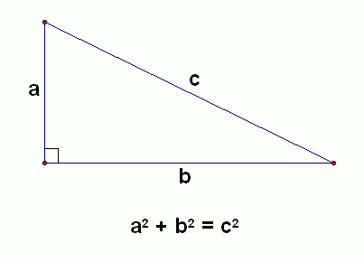

Slide 5
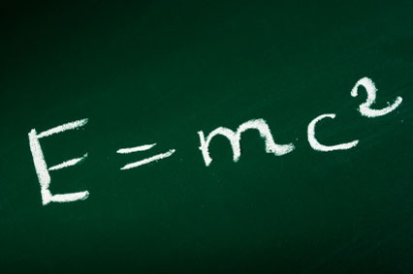

Slide 7
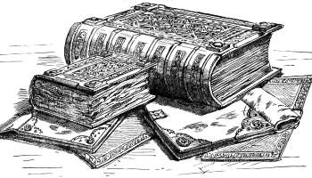

Slide 8
Colossians 3:1-4 (ESV)
¹If then you have been raised with Christ, seek the things that are above, where Christ is, seated at the right hand of God.
² Set your minds on things that are above, not on things that are on earth.
³ For you have died, and your life is hidden with Christ in God.
⁴ When Christ who is your life appears, then you also will appear with him in glory.

Slide 9
” . . .having been buried with him in baptism, in which you were also raised with him through faith in the powerful working of God, who raised him from the dead.” - Colossians 2:12

Slide 10
= CHRIST

Slide 11
Colossians 3:1-4 (ESV)
¹If then you have been raised with Christ, seek the things that are above, where Christ is, seated at the right hand of God.
² Set your minds on things that are above, not on things that are on earth.
³ For you have died, and your life is hidden with Christ in God.
⁴ When Christ who is your life appears, then you also will appear with him in glory.

Slide 12
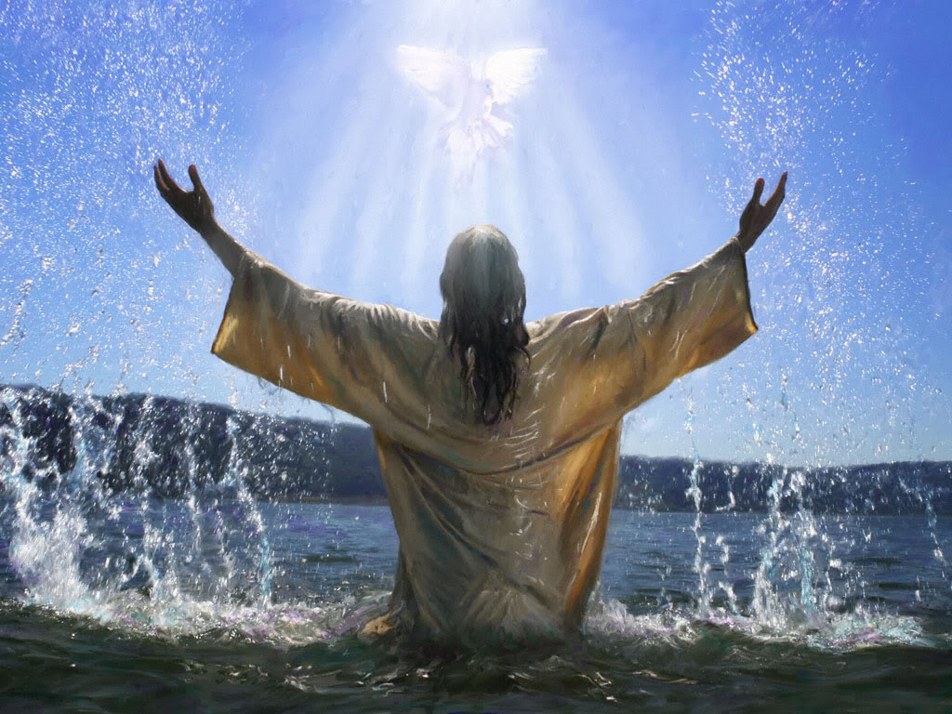

Slide 13
Colossians 3:1-4 (ESV)
¹If then you have been raised with Christ, seek the things that are above, where Christ is, seated at the right hand of God.
² Set your minds on things that are above, not on things that are on earth.
³ For you have died, and your life is hidden with Christ in God.
⁴ When Christ who is your life appears, then you also will appear with him in glory.

Slide 14
Christ = Your Life
Your Life = Christ

Slide 15
Colossians 3:1-4 (ESV)
¹If then you have been raised with Christ, seek the things that are above, where Christ is, seated at the right hand of God.
² Set your minds on things that are above, not on things that are on earth.
³ For you have died, and your life is hidden with Christ in God.
⁴ When Christ who is your life appears, then you also will appear with him in glory.

Slide 16
My Life = Christ

Slide 17
“And this is the testimony, that God gave us eternal life, and this life is in his Son.
Whoever has the Son has life; whoever does not have the Son of God does not have life.”
1 John 5:11-12

Slide 18
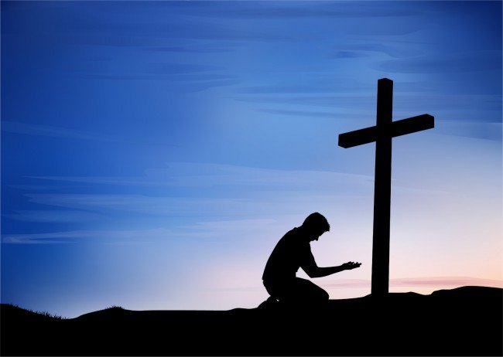
Christ is
your life!

Slide 19
Your life = Christ
His interests =
your interests

Slide 20
His concerns =
your concerns

Slide 21
His cause =
your cause

Slide 22
His ambitions =
your ambitions

Slide 23
His outlook =
your outlook

Slide 24
His security =
your security

Slide 25
Colossians 3:1-4 (ESV)
¹If then you have been raised with Christ, seek the things that are above, where Christ is, seated at the right hand of God.
² Set your minds on things that are above, not on things that are on earth.
³ For you have died, and your life is hidden with Christ in God.
⁴ When Christ who is your life appears, then you also will appear with him in glory.

Slide 26
Your life =
Christ

Slide 27
Colossians 3:1-4 (ESV)
¹If then you have been raised with Christ, seek the things that are above, where Christ is, seated at the right hand of God.
² Set your minds on things that are above, not on things that are on earth.
³ For you have died, and your life is hidden with Christ in God.
⁴ When Christ who is your life appears, then you also will appear with him in glory.

Slide 28
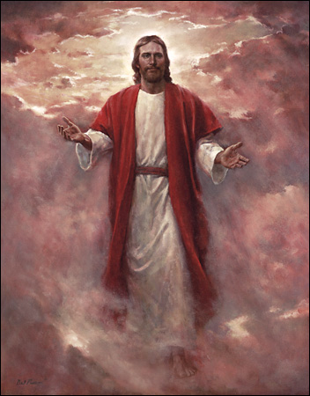

Slide 29
Christ is
your life!

