Slide 1
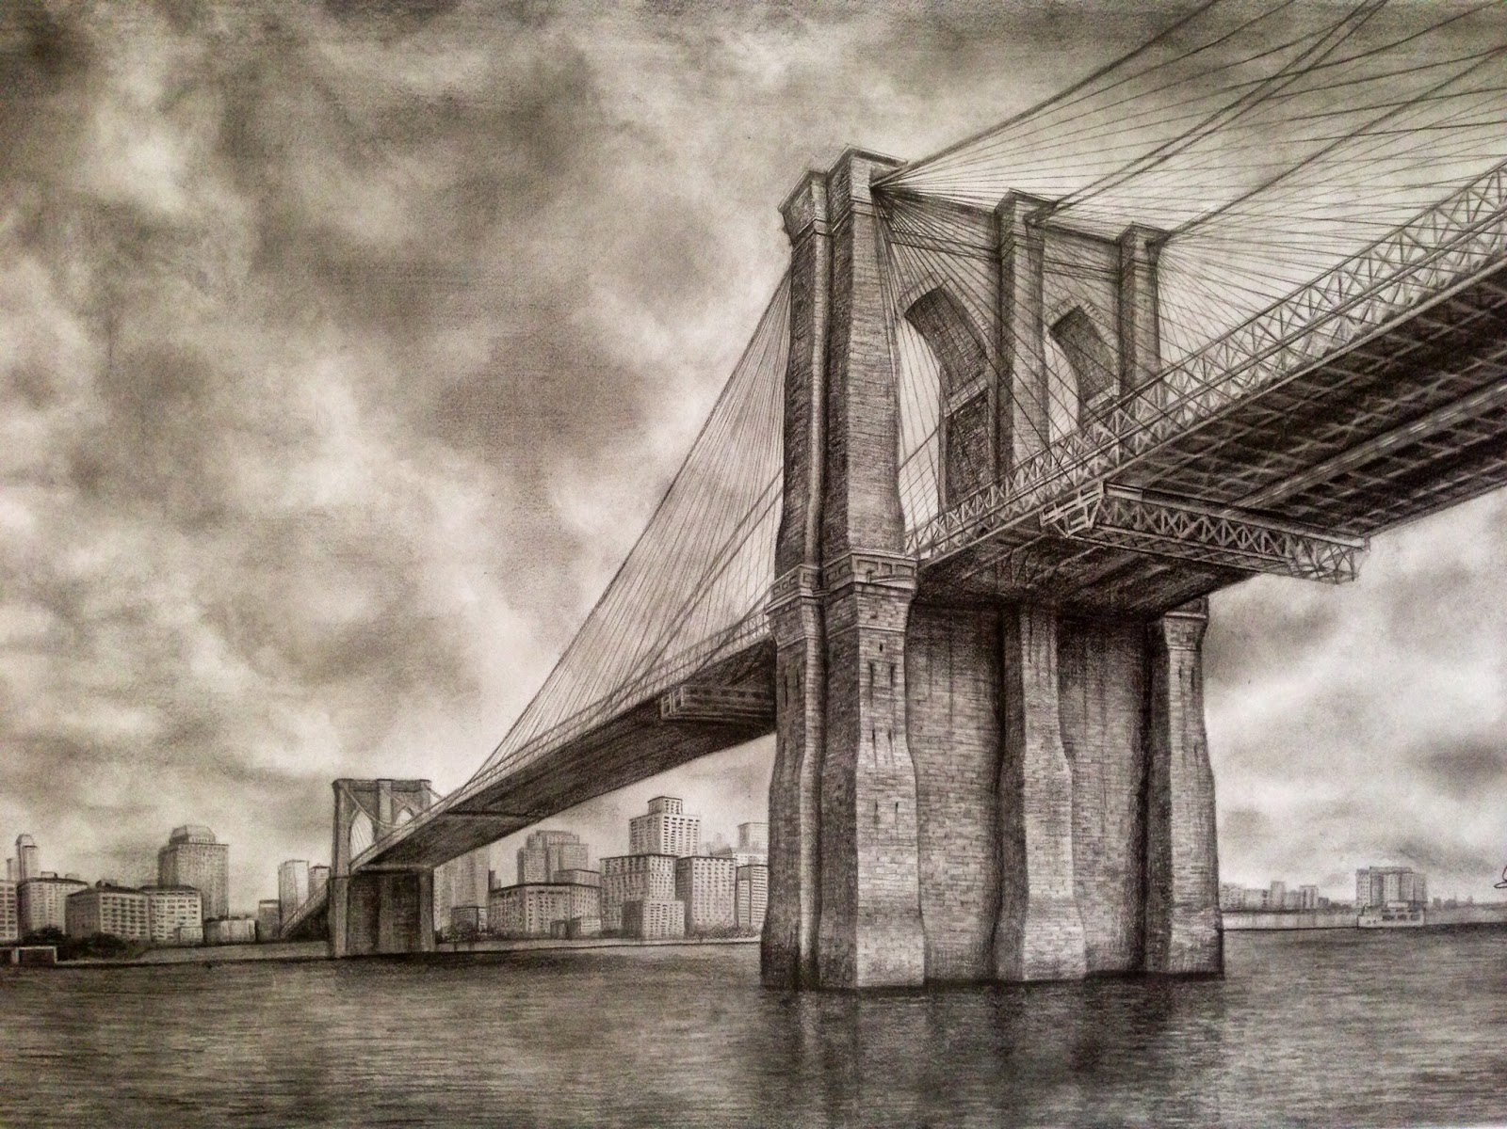
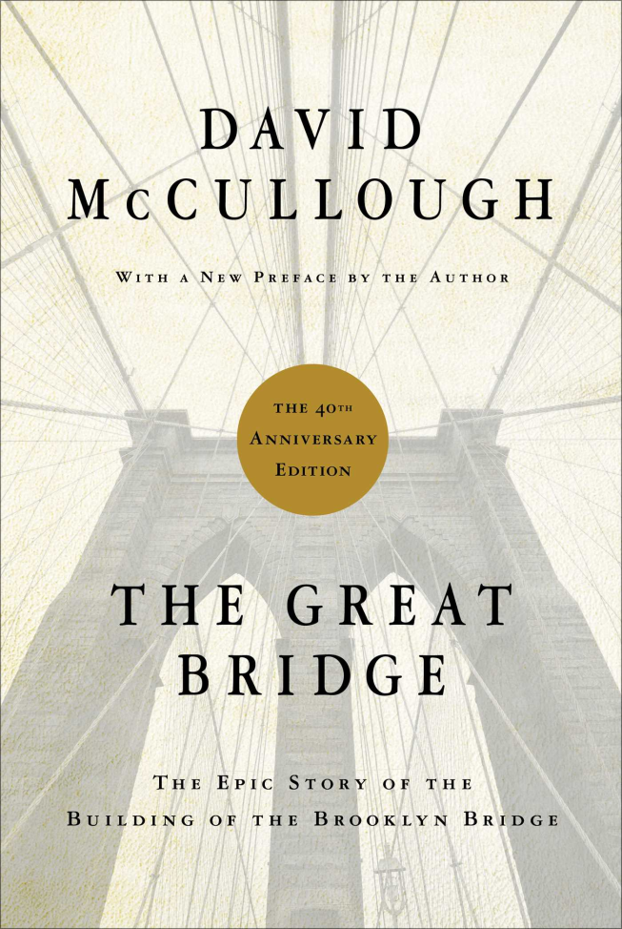

Slide 2
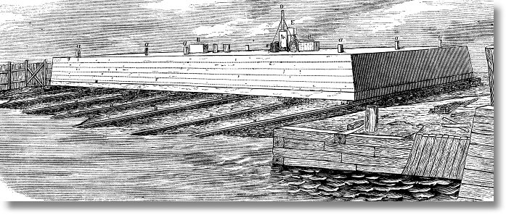

Slide 4
“ . . . as we look not to the things that are seen but to the things that are unseen. For the things that are seen are transient, but the things that are unseen are eternal.”
2 Corinthians 4:18

Slide 5
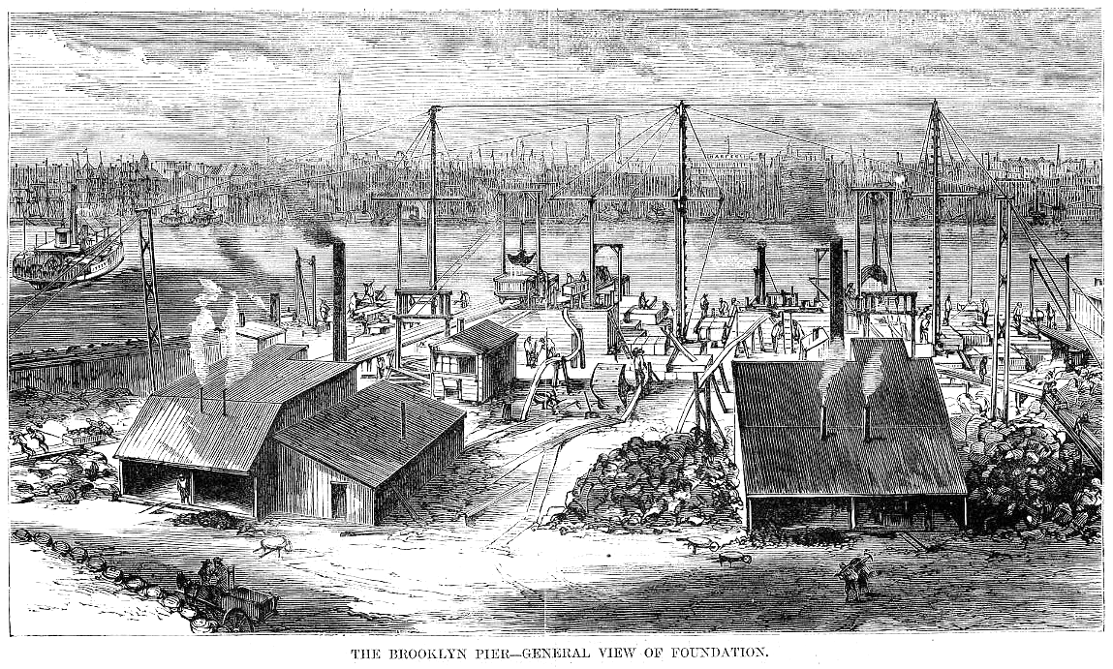

Slide 6
“the great Holy Spirit chapter”

Slide 8
Romans 8:18-25 (ESV)
¹⁸For I consider that the sufferings of this present time are not worth comparing with the glory that is to be revealed to us.
¹⁹For the creation waits with eager longing for the revealing of the sons of God.
²⁰For the creation was subjected to futility, not willingly, but because of him who subjected it, in hope
²¹that the creation itself will be set free from its bondage to corruption and obtain the freedom of the glory of the children of God.

Slide 9
Romans 8:18-25 (ESV)
²²For we know that the whole creation has been groaning together in the pains of childbirth until now.
²³And not only the creation, but we ourselves, who have the firstfruits of the Spirit, groan inwardly as we wait eagerly for adoption as sons, the redemption of our bodies.
²⁴For in this hope we were saved. Now hope that is seen is not hope. For who hopes for what he sees?
²⁵But if we hope for what we do not see, we wait for it with patience.

Slide 10
“Already” vs.
“Not Yet”

Slide 11
Romans 8:18-25 (ESV)
²²For we know that the whole creation has been groaning together in the pains of childbirth until now.
²³And not only the creation, but we ourselves, who have the firstfruits of the Spirit, groan inwardly as we wait eagerly for adoption as sons, the redemption of our bodies.
²⁴For in this hope we WERE saved. Now hope that is seen is not hope. For who hopes for what he sees?
²⁵But if we hope for what we do not see, we wait for it with patience.

Slide 12
“Already” vs.
“Not Yet”

Slide 13
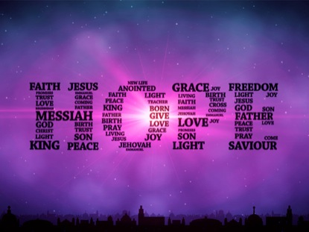

Slide 14
“Hope that is seen is not hope. For who hopes for what he sees?
But, if we hope for what we do not see, we wait for it with patience”.

Slide 15
Futurity
Certainty

Slide 16
Romans 8:18-25 (ESV)
¹⁸For I consider that the sufferings of this present time are not worth comparing with the glory that is to be revealed to us.
¹⁹For the creation waits with eager longing for the revealing of the sons of God.
²⁰For the creation was subjected to futility, not willingly, but because of him who subjected it, in hope
²¹that the creation itself will be set free from its bondage to corruption and obtain the freedom of the glory of the children of God.

Slide 17
Romans 8:18-25 (ESV)
²²For we know that the whole creation has been groaning together in the pains of childbirth until now.
²³And not only the creation, but we ourselves, who have the firstfruits of the Spirit, groan inwardly as we wait eagerly for adoption as sons, the redemption of our bodies.
²⁴For in this hope we were saved. Now hope that is seen is not hope. For who hopes for what he sees?
²⁵But if we hope for what we do not see, we wait for it with patience.

Slide 18
VIBRANT PATIENCE

Slide 19
“ . . . the Christian Attitude must be determined NOT by the frustrations of the present, but by the hope of the future.”

Slide 20
“BALANCING ACT”
vs
Eager
Patient

Slide 21
Romans 8:18-25 (ESV)
²²For we know that the whole creation has been groaning together in the pains of childbirth until now.
²³And not only the creation, but we ourselves, who have the firstfruits of the Spirit, groan inwardly as we wait eagerly for adoption as sons, the redemption of our bodies.
²⁴For in this hope we were saved. Now hope that is seen is not hope. For who hopes for what he sees?
²⁵But if we hope for what we do not see, we (eagerly) wait for it with patience.

Slide 22
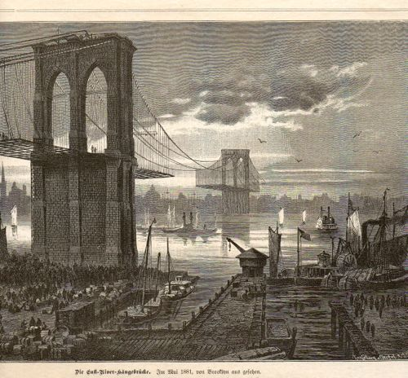

Slide 23
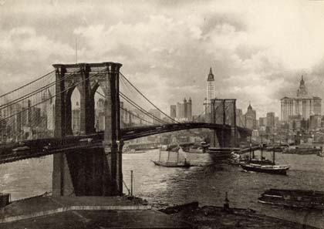

Slide 26
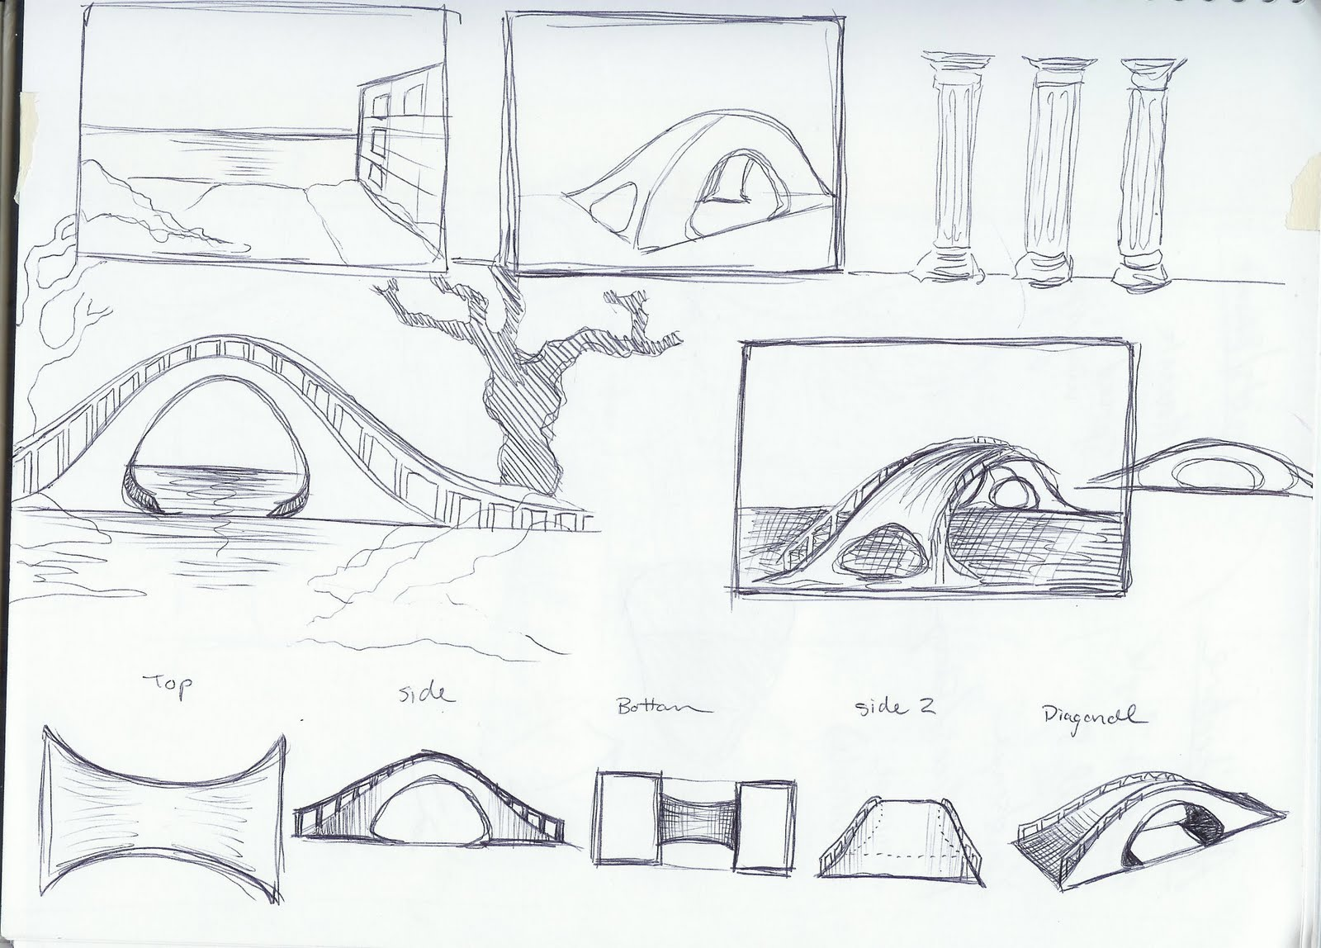

Slide 27
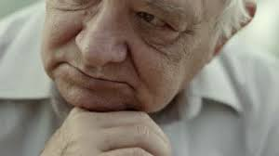
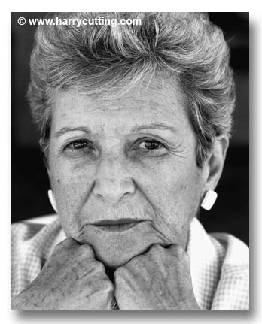
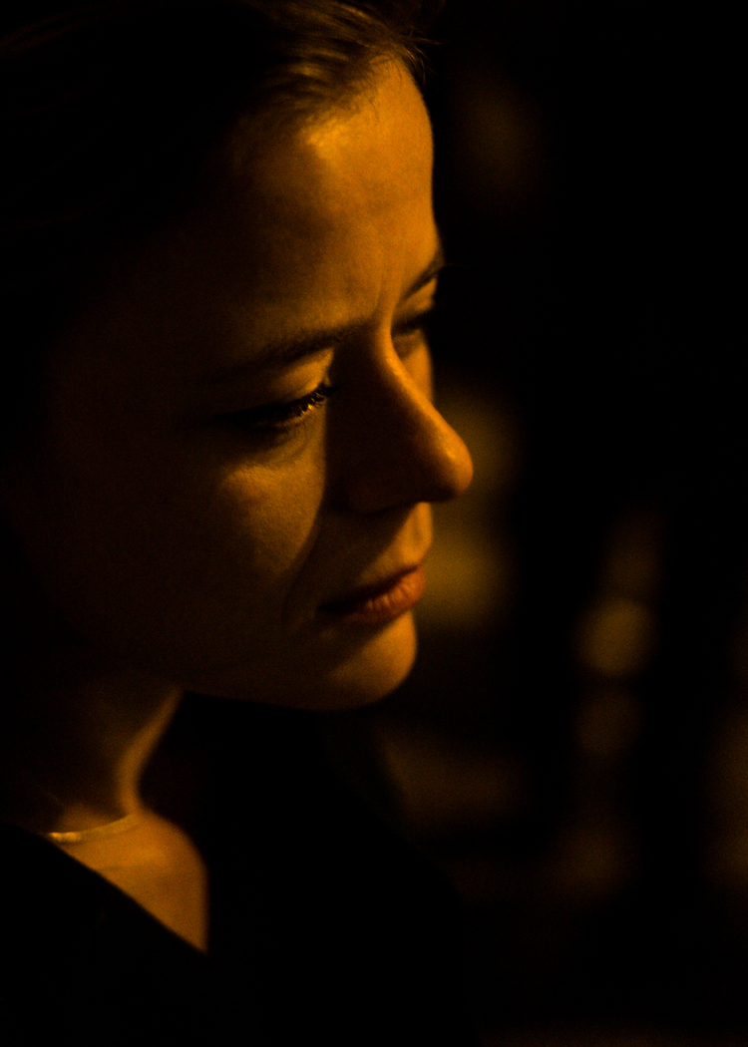
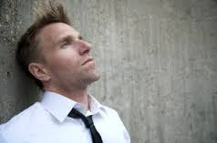

Slide 28
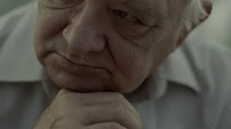
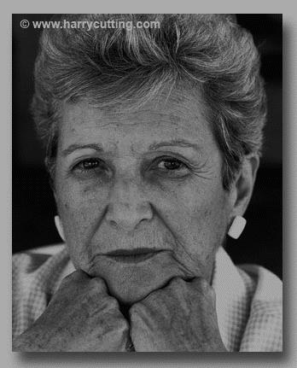
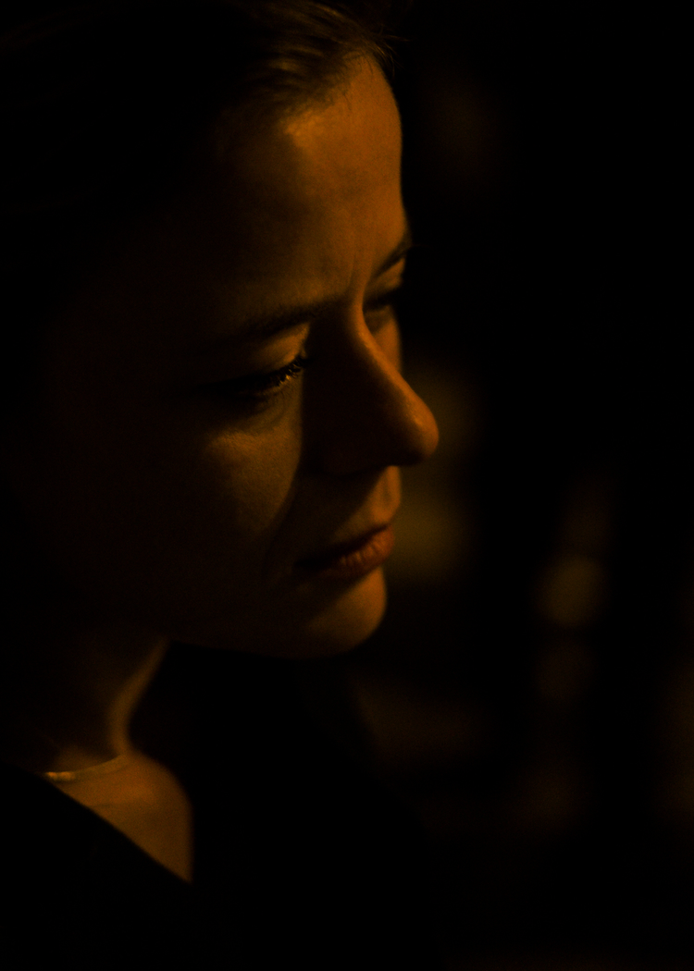
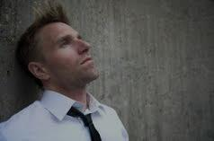
Not so eager that we lose patience,
not so patient that we lose hope.

Slide 29
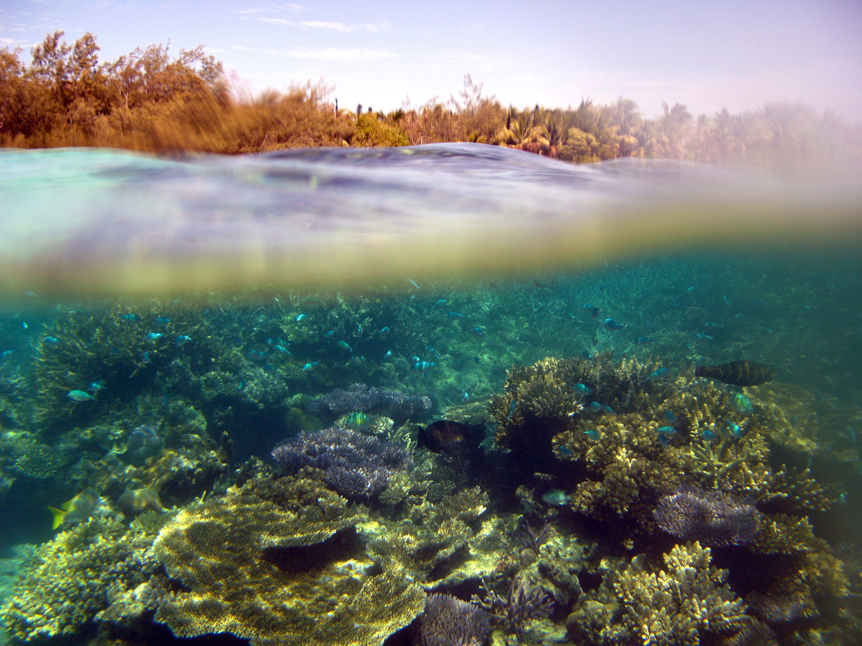
Are you building below
the waterline?

Slide 30
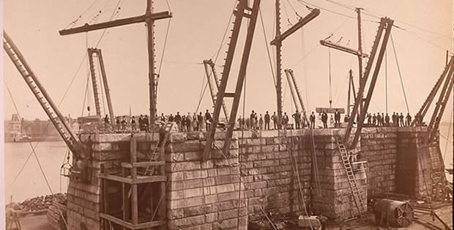

Slide 31
VIBRANT PATIENCE

