Slide 1
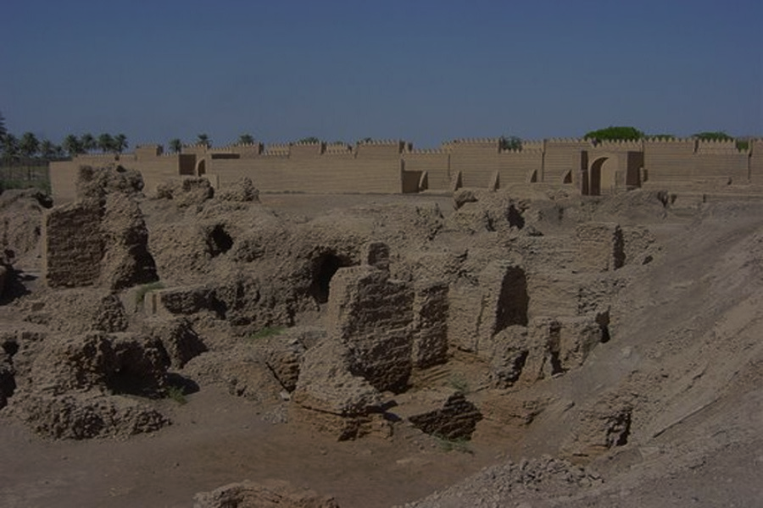
“I Will vs. Thy Will”
(Isaiah 14/Matthew 26)
Mark Mason July 19, 2015

Slide 2
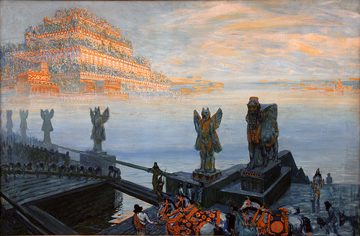
³ When the Lord has given you rest from your pain and turmoil and the hard service with which you were made to serve,
⁴ you will take up this taunt against the king of Babylon . . .”
Isaiah 14:3-4

Slide 3
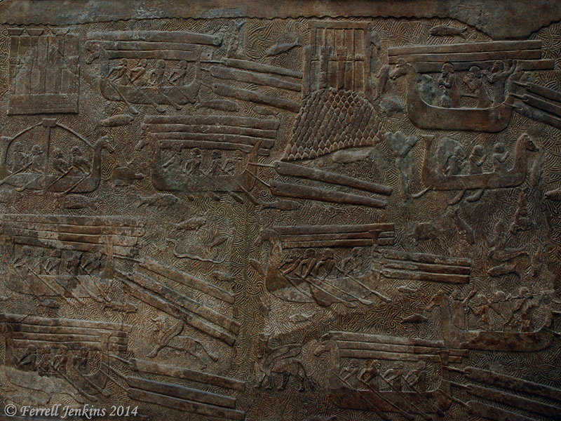
Isaiah 14:12-17 (ESV)
¹²“How you are fallen from heaven,
O Day Star, son of Dawn!
How you are cut down to the ground,
you who laid the nations low!
¹³You said in your heart,
‘I will ascend to heaven;
above the stars of God
I will set my throne on high;
I will sit on the mount of assembly
in the far reaches of the north;
¹⁴I will ascend above the heights of the clouds;
I will make myself like the Most High.’

Slide 4
Isaiah 14:12-17 (ESV)
¹⁵But you are brought down to Sheol,
to the far reaches of the pit.
¹⁶Those who see you will stare at you
and ponder over you:
‘Is this the man who made the earth tremble,
who shook kingdoms,
¹⁷who made the world like a desert
and overthrew its cities,
who did not let his prisoners go home?’

Slide 5
Isaiah 14:12-17 (ESV)
¹²“How you are fallen from heaven,
O Day Star, son of Dawn!
How you are cut down to the ground,
you who laid the nations low!
¹³You said in your heart,
‘I will ascend to heaven;
above the stars of God
I will set my throne on high;
I will sit on the mount of assembly
in the far reaches of the north;
¹⁴I will ascend above the heights of the clouds;
I will make myself like the Most High.’

Slide 6
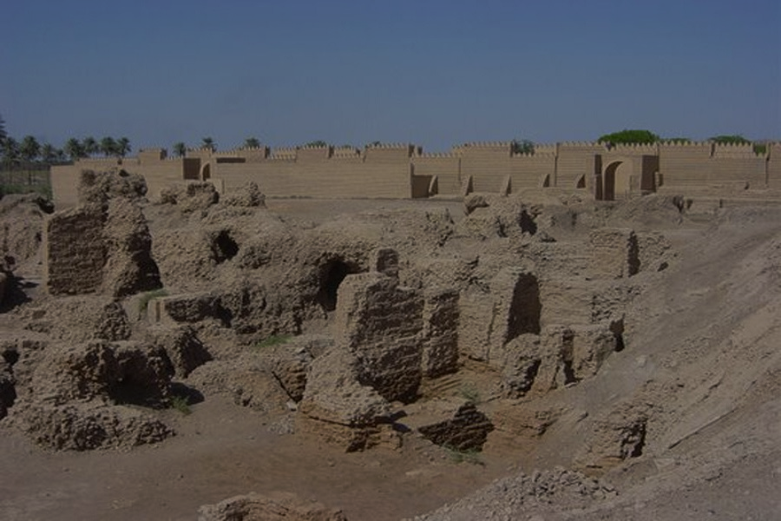
“Uh, No, You Won’t!”

Slide 8
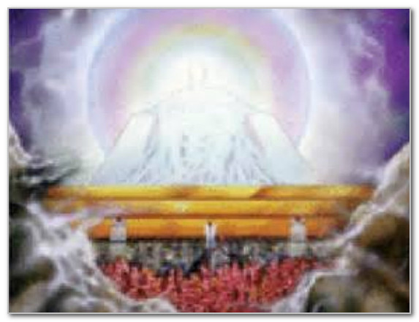
“I WILL”

Slide 9
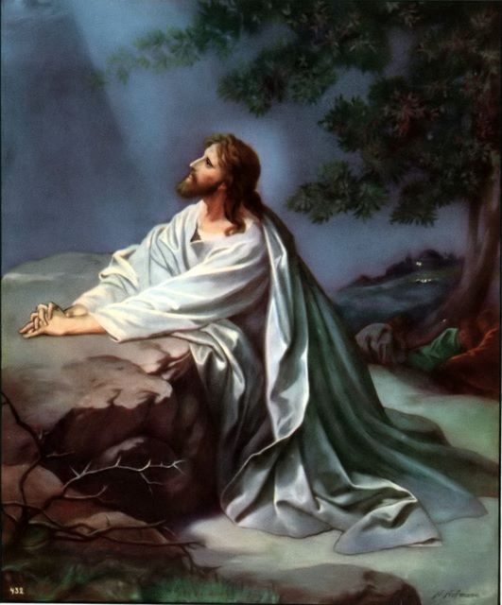

Slide 10
³⁶Then Jesus went with them to a place called Gethsemane, and he said to his disciples, “Sit here, while I go over there and pray.”
³⁷And taking with him Peter and the two sons of Zebedee, he began to be sorrowful and troubled.
³⁸Then he said to them, “My soul is very sorrowful, even to death; remain here, and watch with me.”
³⁹And going a little farther he fell on his face and prayed, saying, “My Father, if it be possible, let this cup pass from me; nevertheless, not as I will, but as you will.”
⁴⁰And he came to the disciples and found them sleeping. And he said to Peter, “So, could you not watch with me one hour?
MATTHEW 26:36-44

Slide 11
⁴¹Watch and pray that you may not enter into temptation. The spirit indeed is willing, but the flesh is weak.”
⁴²Again, for the second time, he went away and prayed, “My Father, if this cannot pass unless I drink it, your will be done.”
⁴³And again he came and found them sleeping, for their eyes were heavy.
⁴⁴So, leaving them again, he went away and prayed for the third time, saying the same words again.
MATTHEW 26:36-44

Slide 12
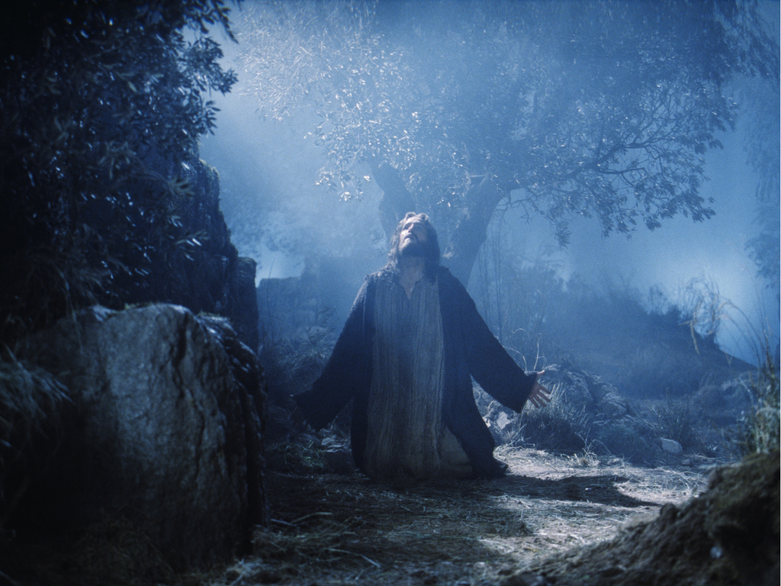
“I Will” vs. “Thy Will”

Slide 13
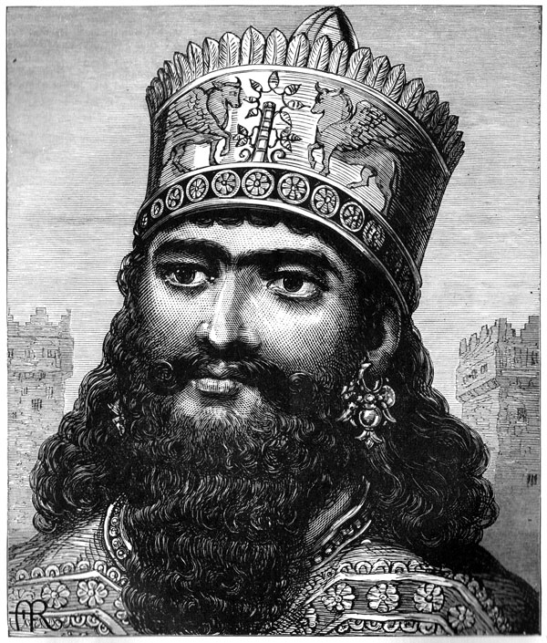
“I Will”
“I Will”
“I Will”
“I Will”
“I Will”

Slide 14
“Thy Will”
“Thy Will”
“Thy Will”

Slide 15
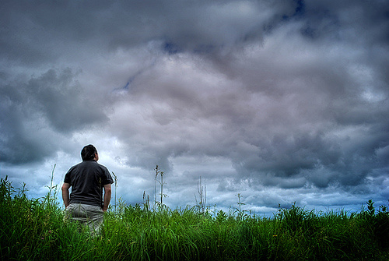
My Will, or
Thy Will?

