Slide 2
June 1993

Slide 3
“Who Am I and What Am I Doing Here?”
June 13, 1993
June 14, 2015
Mark Mason

Slide 4
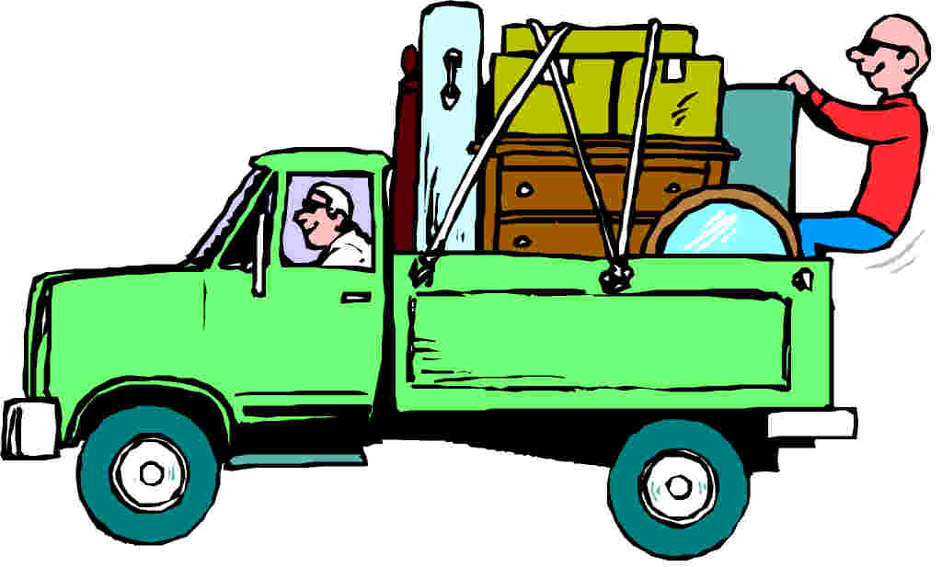

Slide 5
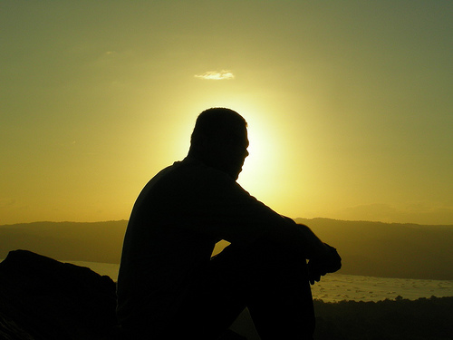

Slide 6
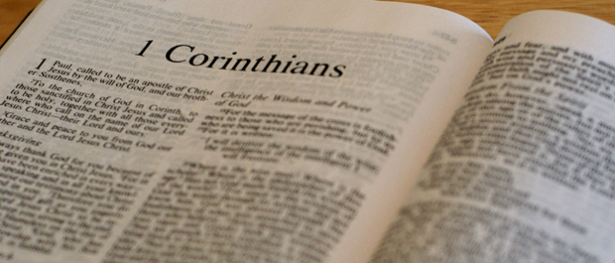

Slide 7
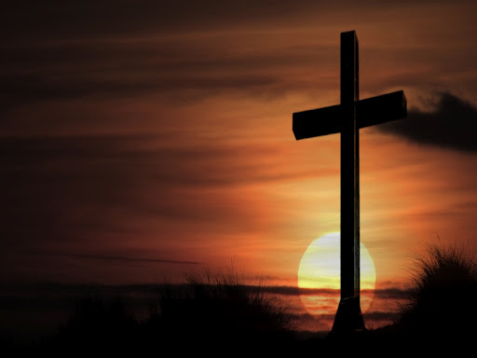
“And I, when I came to you, brothers, did not come proclaiming to you the testimony of God with lofty speech or wisdom.
For I decided to know nothing among you except Jesus Christ and him crucified.
And I was with you in weakness and in fear and much trembling,

Slide 8
and my speech and my message were not in plausible words of wisdom, but in demonstration of the Spirit and of power, so that your faith might not rest in the wisdom of men but in the power of God.”
1 Corinthians 2:1-5

Slide 9
He denies relying upon human wisdom in his ministry.
He sets forth his main message to them: Christ crucified.
He attributes any success to the power of the spirit of God.

Slide 10
1 Corinthians 2:1
“And I, when I came to you, brothers, did not come proclaiming to you the testimony of God with lofty speech or wisdom.”

Slide 11
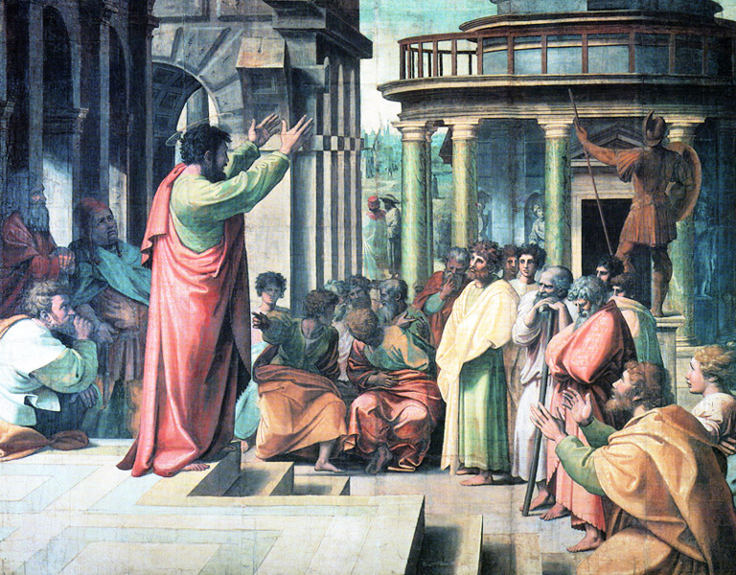

Slide 12
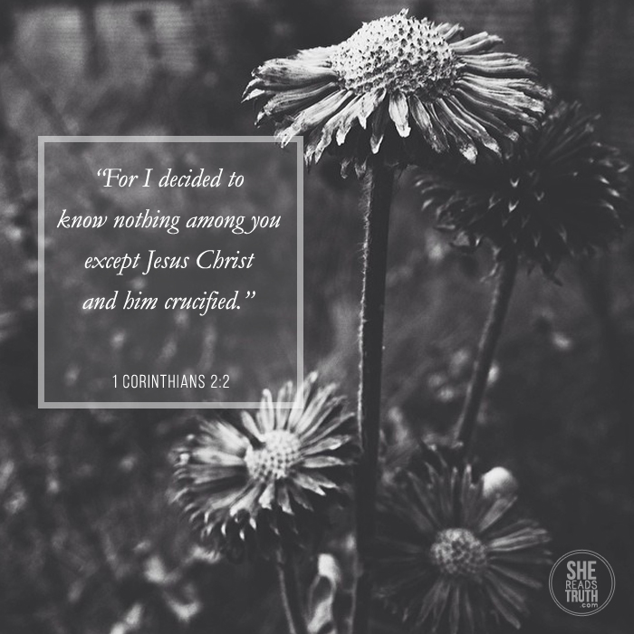

Slide 14
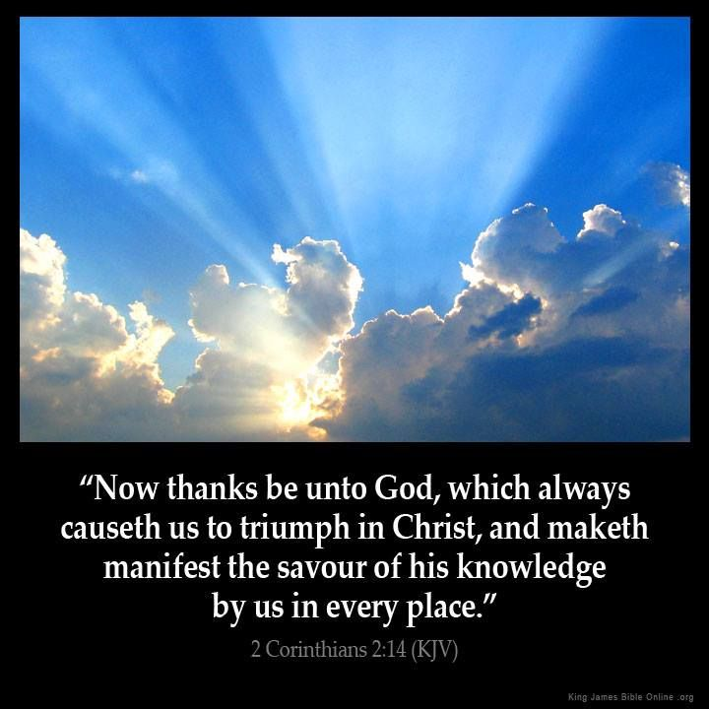
. ³And I was with you in weakness and in fear and much trembling,
⁴and my speech and my message were not in plausible words of wisdom, but in demonstration of the Spirit and of power,
⁵so that your faith might not rest in the wisdom of men but in the power of God.

Slide 15
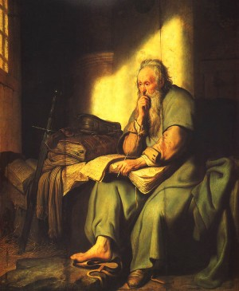
“I was with you in weakness and in fear and much trembling…”

Slide 16
“My speech and my message were not in plausible words of wisdom”

Slide 17
. ³And I was with you in weakness and in fear and much trembling,
⁴and my speech and my message were not in plausible words of wisdom, but in demonstration of the Spirit and of power,
⁵so that your faith might not rest in the wisdom of men but in the power of God.

Slide 19
“For Christ did not send me to baptize but to preach the gospel, and not with words of eloquent wisdom, lest the cross of Christ be emptied of its power.”
- 1 Corinthians 1:17 ESV

Slide 21
Galatians 6:14
“But far be it from me to boast except in the cross of our Lord Jesus Christ, by which the world has been crucified to me, and I to the world.”

Slide 22
Not relying upon human wisdom.
Focus on Christ crucified.
Give credit for all good things to God.

